Slide 1
Compiler principles
Processor architectures
Jakub Yaghob

Slide 2
Processor architectures
Processor architecture is a target language
For compilers targeting a processor code
It influences the compiler backend, namely code generator
It can affect an intermediate code form and instructions, used high-level optimizations

Slide 3
Registers
The fastest memory
Precious resource
x86 has 7 of 32-bits integer registers
IA-64 has 128 of 64-bits integer registers
Different register types for different data types
Integer, floating point, address, vector
Different access modes
Direct
Stack (FPU)

Slide 4
Instruction set
RISC
Simple instructions, small number (e.g. no division)
CISC
Complex instructions, wide repertoire
Load-Execute-Store
Orthogonality
x86 has non-orthogonal instruction set

Slide 5
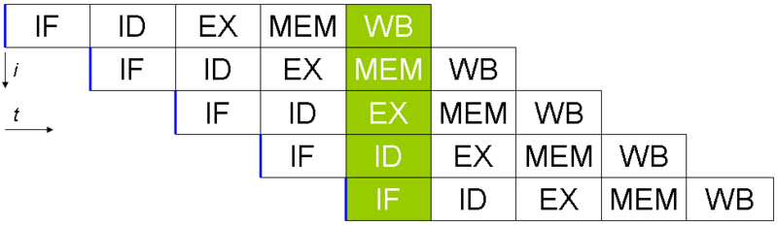
Pipelining
Next instruction fetch and decode started before the previous instruction was finished
Each stage and each instruction has a latency
Problem with operand dependency (RAW)

Slide 6
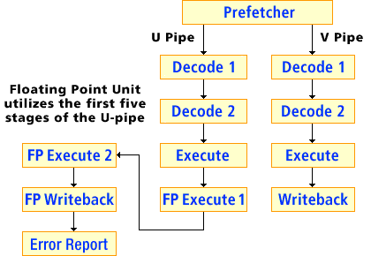
Superscalar processor
More equal units capable of parallel instruction execution

Slide 7
Out-of-Order Execution
Instruction fetch
Instruction dispatch to an instruction queue
The instruction waits until its input operands are available
The instruction is issued to its execution unit
The results are queued
When all older instructions written their results to the register file, the instruction writes its result

Slide 8
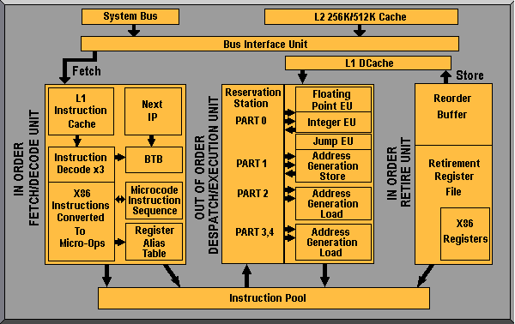
Out-of-Order Execution – AMD

Slide 9
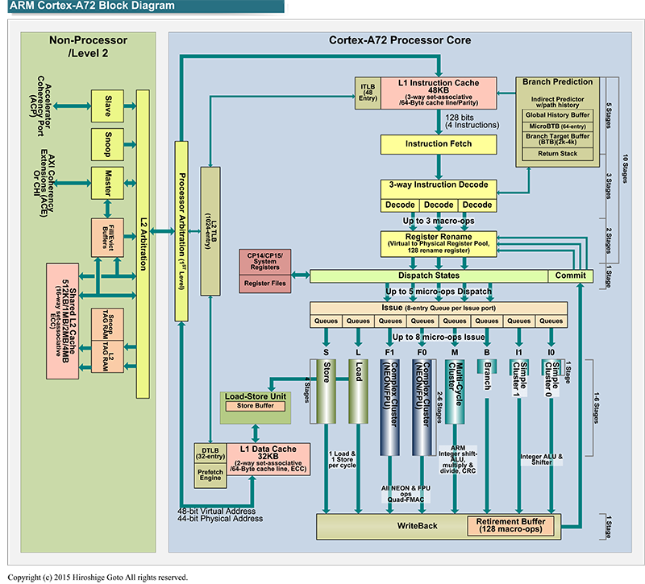
Out-of-Order Execution – ARM Cortex-A72

Slide 10
Branch prediction
Deep pipelines have a problem with not taken conditional jumps
Dynamic branch prediction
BTB
CPU uses history (patterns of some length) for branch prediction
Static prediction used when no history is available
Static branch prediction
No hint
Forward jump is not taken, backward jump is taken
Hint
A compiler computes branch probability and generates appropriate branch hint
Delay slot

Slide 11
Speculative execution
Execution of a code in advance which is not used later
Significant disproportion between CPU and memory speed
Usually used for read operations in advance
CPU postpones write operations
Memory barriers
Code speculation
Check for successful execution
Data speculation
Moved forward even with possible pointer-aliasing

Slide 12
SIMD instructions
Sometimes called multimedia instructions
Integer and float data types
Expression vectorization already in intermediate code or later in code generation
Considerable (constant) execution speedup
Sometimes difficult detection of vectorization opportunity

Slide 13
VLIW
Instruction encoding
Templates in IA-64
ILP (Instruction Level Parallelism)
Concurrency encoded directly in instructions
Dependencies in concurrency group
RAW, WAW disallowed
WAR allowed

Slide 14
SoC (System on Chip) + microcontrollers
Small memory space
Optimization for size of code and data
One-bit variables
Separated memory spaces
Code and several data address spaces
Different access
Simple pipeline, no superscalarity

Slide 15
Code generation
Memory allocation
Instruction selection
Register allocation
Instruction scheduling
Output
Output file format
Objects
Code, data, relocations, external and public symbols, debug information

Slide 16
Memory allocation
Code
Jump resolving
Static data
Global data
Stack
Local variables and function parameters
Size of data types
Memory placement
Data alignment
Decide, what is in memory and what gets an allocated register

Slide 17
Instruction selection
1:N
One intermediate code instruction corresponds with N target instructions
Simple, the generated code is considerably suboptimal
M:N
M intermediate code instructions correspond with N target instructions
NP-complete problem of selection
Heuristics
More possibilities of code generation
CISC, SIMD, VLIW
Non-orthogonal instruction set problem

Slide 18
Register allocation
What is placed to the memory and what is placed into a register of a required register type
Non-orthogonal instruction set problem
Coloring of a graph of variable liveness
The graph is constructed only for a selected variable type (e.g. integer variables)
The number of colors is equal to the number of available registers of the selected type
When there is no graph coloring, remove “less important” graph nodes and try again
We don’t need to find an optimal graph coloring, we are looking for any graph coloring

Slide 19
Instruction scheduling
Rearrange instructions keeping semantic and avoiding pipeline stalls
RAW, WAW, WAR dependencies
Construct graph of data dependency
Oriented graph, where an edge represents instruction ordering for data availability
Find any topological order
Instruction latency, speculations, superscalarity, out-of-order execution
Usually performed upon one basic block

